Slide 1
SITO WEB: NOTHING ITALIA
Link al sito web replicato: https://it.nothing.tech/?utm_medium=PaidSearch&utm_source=Google&utm_campaign=HQ_PaidSearch_Google_Lower_Brand_IT_IT&utm_content=Brand&gad_source=1&gclid=CjwKCAjw7pO_BhAlEiwA4pMQvP2W4q0_DMKF4FYBhsuOTcSuftjvxOsVlQ5TgrTW0E9S9VT5NTT_LhoCHeoQAvD_BwE

Slide 2
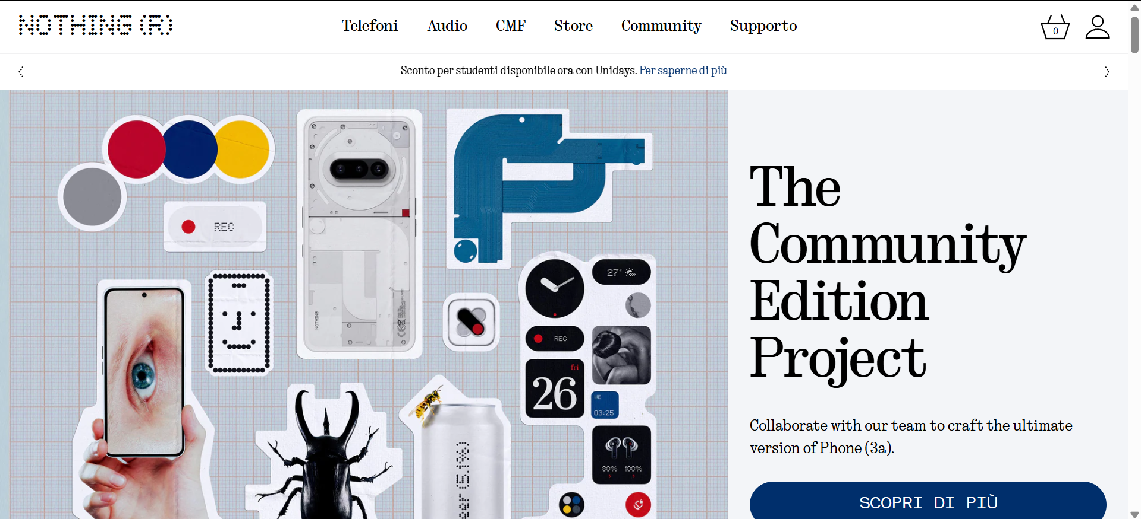

Slide 3
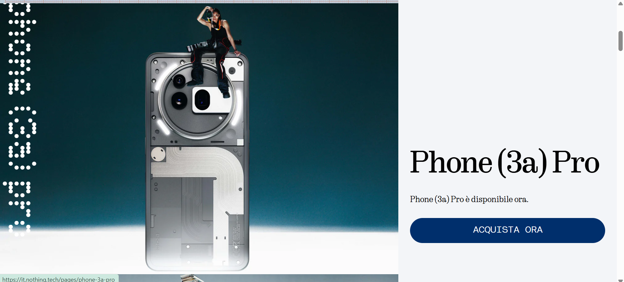

Slide 4
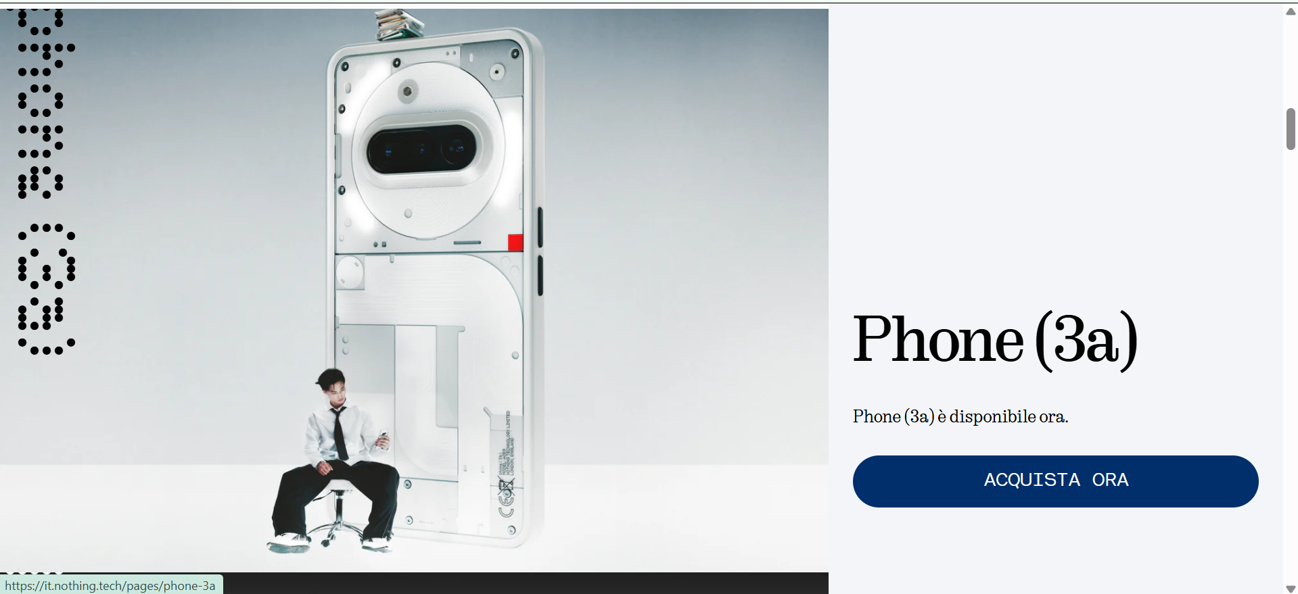

Slide 5
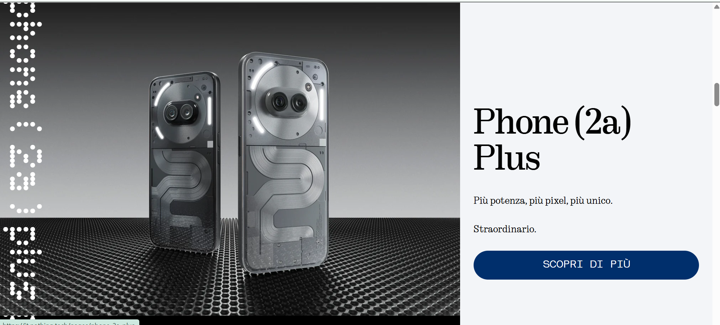

Slide 6
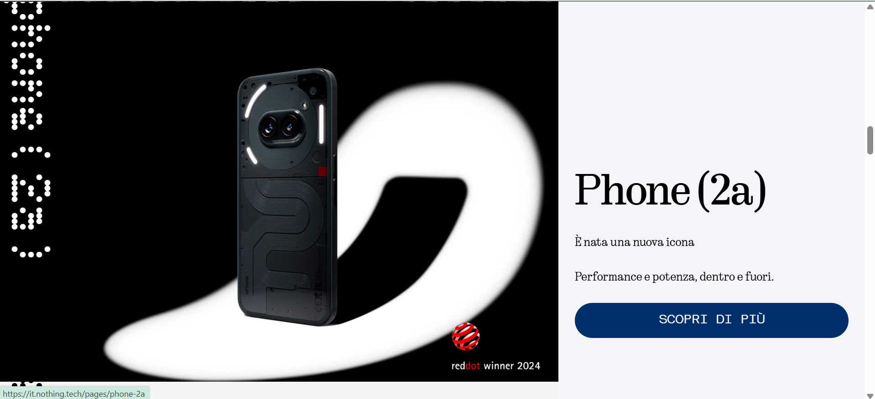

Slide 7
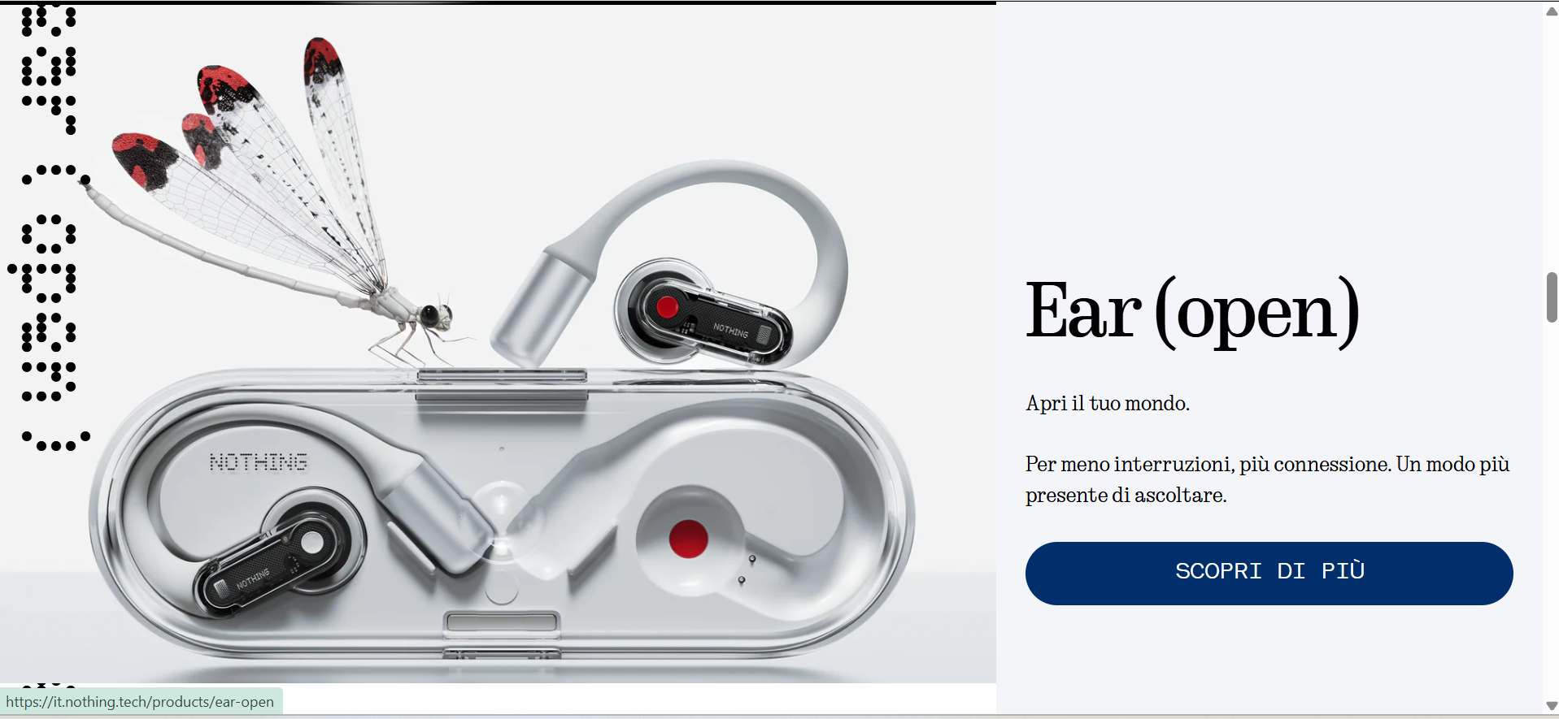

Slide 8
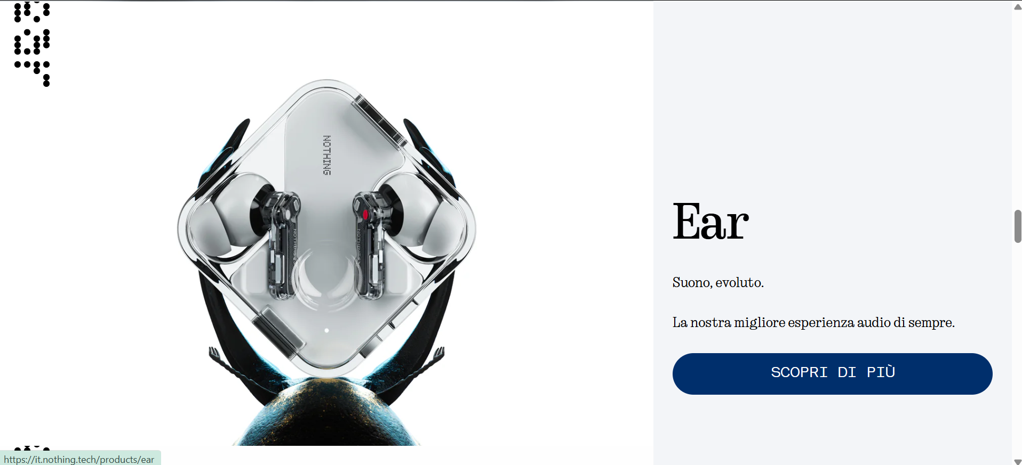

Slide 9
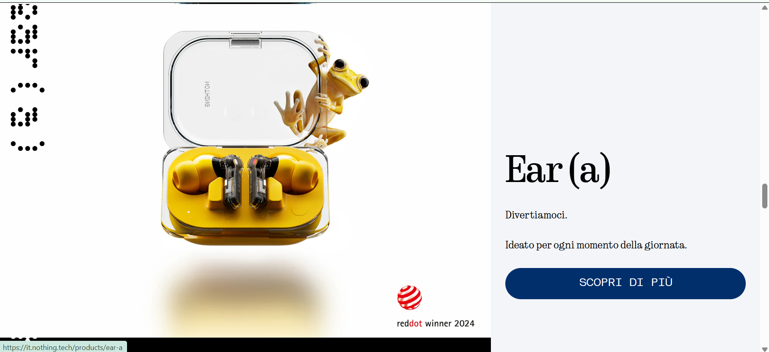

Slide 10
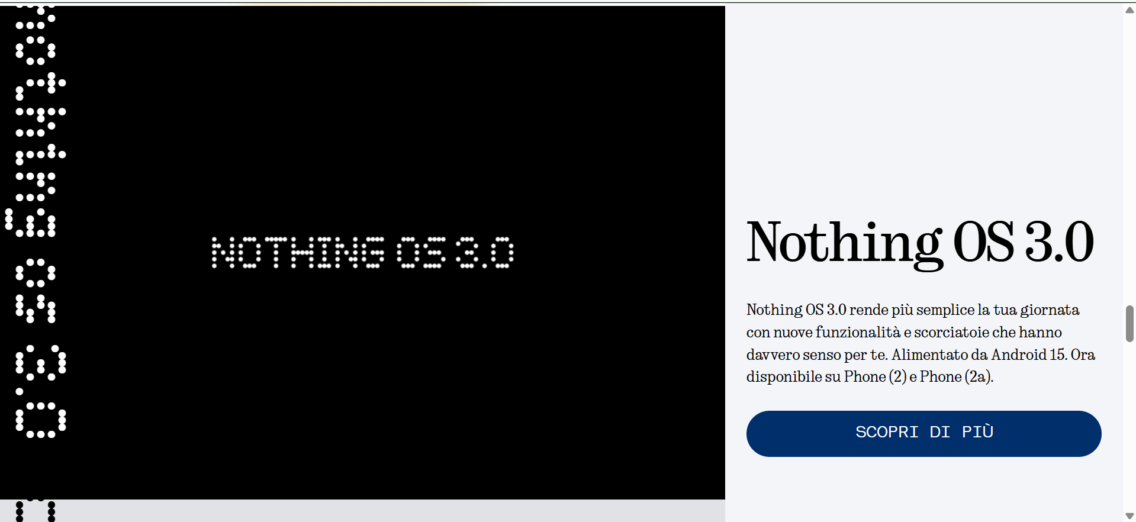

Slide 11
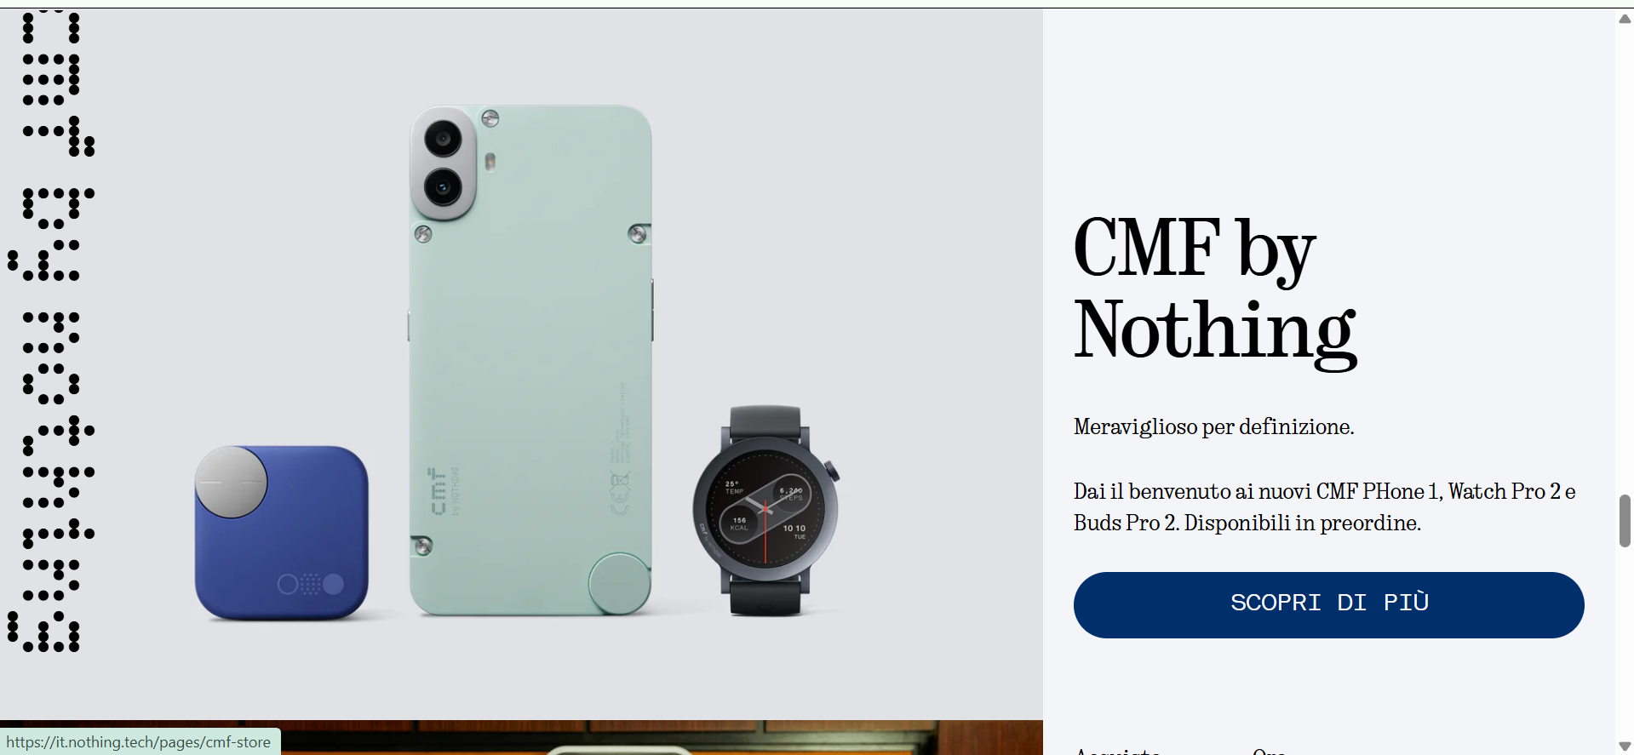

Slide 12
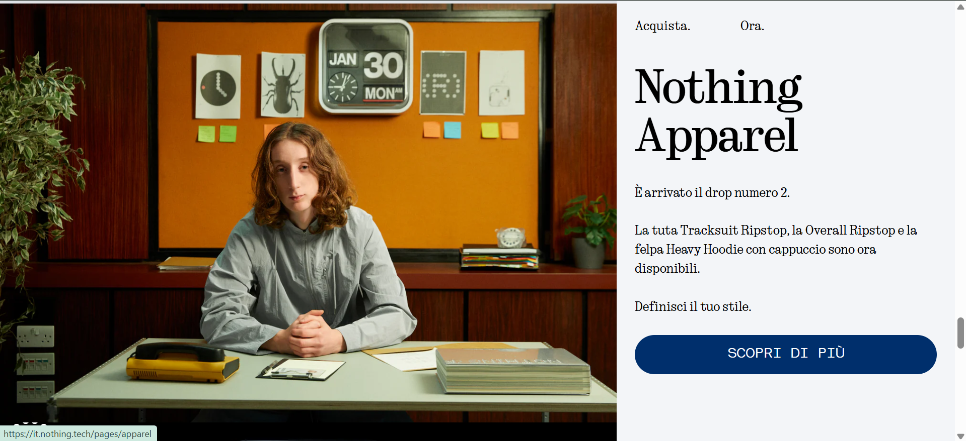

Slide 13
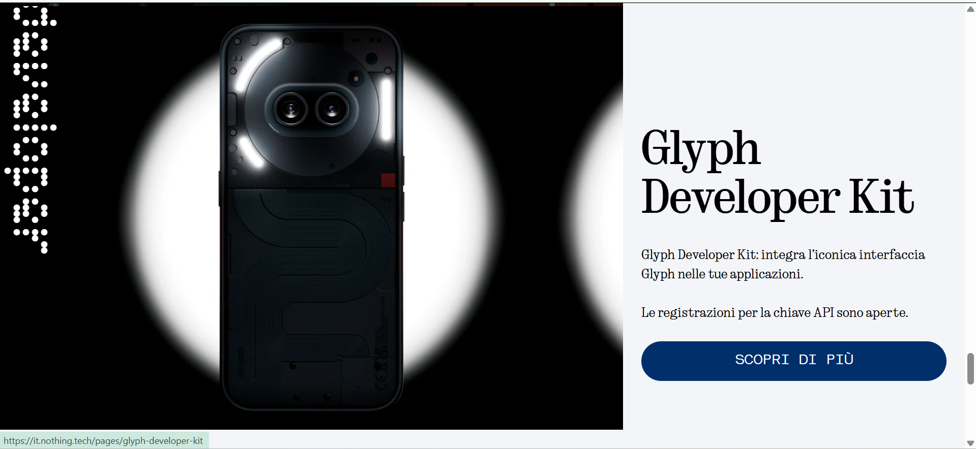

Slide 14
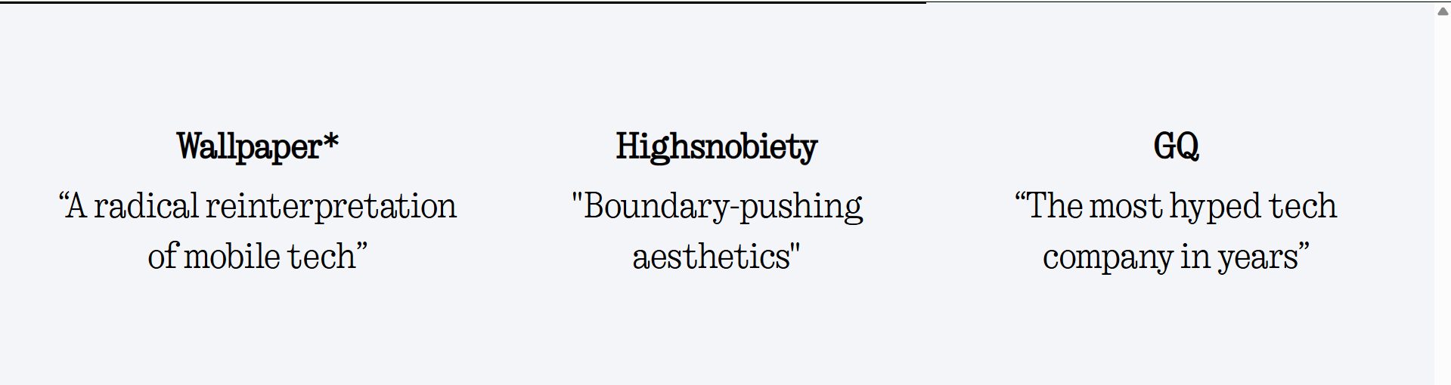

Slide 15
